Slide 1

Impact of Malnutrition On Adult Patients After Elective Cardiac Surgery
Group 4
Devesh Bajaj
Arnav Muley
Shreyash Kharat
Pratichi Paramita

Slide 2
Objectives
To determine whether malnutrition affects post operative survival of patients who have gone through elective cardiac surgery.
To improve clinical practice and modify malnutrition associated outcomes.
To determine whether any parameters other than malnutrition affect the survival of the subjects.

Slide 3

Data Description
3
1

Slide 4
Data Description
The data for the study was collected in 5 different categories based on time:
1.Medical records, baseline demographics and nutritional data: These included Age, Gender, Primary pathology(Coronary Artery Disease(CAD), Heart Valve Disease(HVD)), Primary Diagnosis, Type of surgery, Redo surgery, Diabetes, NYHA class, Logistic EuroSCORE, SNAQ, MUST, MNA, NRS_2002, SGA Grade, BMI. This part of the data was recorded before the operation
2.Preoperative data: Total Lymphocytes count, Total blood protein, Albumin level in blood, Thrombocytes(platelets), C reactive protein level in blood, Baseline Left Ventricle Ejection Fraction. This part of the data was recorded just before the operation
3.Intraoperative data: Cardiopulmonary Bypass time(CPB time) during surgery, Aortic Cross Clamp time(ACC time) during surgery. This part of the data was recorded during the operation.

Slide 5
Data Description
4. Postoperative data: These include the post operative data collected during the hospitalization such as mechanical ventilation time after surgery, New dialysis(development of acute kidney failure requiring new dialysis after surgery during hospitalization), Bleeding, ICU stay, Hospitalization duration, Readmission to ICU, in hospital mortality, New onset Atrial fibrillation, Delirium, Inotropes, Cardiac Arrhythmia, Bradycardia.
5. Follow-up data: This part includes the data acquired by both electronic medical records and phone interviews. It includes Survival (total number of days alive after surgery), Death (whether the patient died during the follow up period). In this category the data was recorded till the patient was lost to follow up or the death of patient. The data where the patient was lost to follow-up was denoted by "lost" in the original dataset.

Slide 6
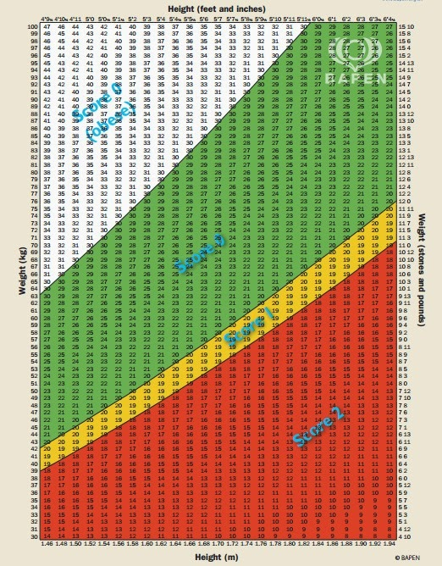
Data Description
In the present study, we used the MUST. because of its higher sensitivity for the detection of malnutrition in cardiac surgery settings.
A total of 1210 eligible patients hospitalized between January 1, 2011, and August 31, 2011, were enrolled to the trial and passed nutritional screening was performed. The inclusion criteria were as follows: (1) older than 18 years and (2) elective cardiac surgery under CPB. The exclusion criteria were as follows: (1) emergency surgery, (2) aortic surgery performed under deep hypothermic circulatory arrest, (3) pulmonary thromboembolism requiring thrombectomy, and (4) off-pump surgery. The following patients were excluded: those operated without CPB ( n = 15) and those who underwent surgery under deep hypothermic circulatory arrest ( n = 8). Thus, the data of 1187 patients were used
Both electronic medical records and phone interviews were used for survival data collection. Attempts to collect data by phone have been performed twice: between August 1,2012, to October 30, 2012, and between August 10, 2019, to November 15, 2019. Long-term follow-up was conducted by phone interview. If the patient had died, family members were asked about the date and cause of death. The phone interviews were successful in 466 patients in 2012 and 397 patients in 2019.

Slide 7
Data Description
The study consisted of a total of 1187 patients. Cardiac surgery included Coronary Artery Bypass Graft (CABG) surgery in 557(47%) patients, valve surgery in 506(42.6%) patients and combined CABG+ valve surgery in 124(10.4%) patients.
Malnutrition of medium to high risk was identified in 201 (16.9%) patients as per the nutritional screening by the MUST test on admission. Differences between groups with and without risk of malnutrition were categorized by Gender, New York Heart Association (NYHA) functional class, Logistic EuroSCORE, Primary Diagnosis and BMI as portrayed in table 1 on the next page.
Malnutrition was found to be higher in HVD cohort of patients. Proportions of patients with heart valve disease (HVD) were 75% and 46% in groups with and without malnutrition risk respectively.

Slide 8
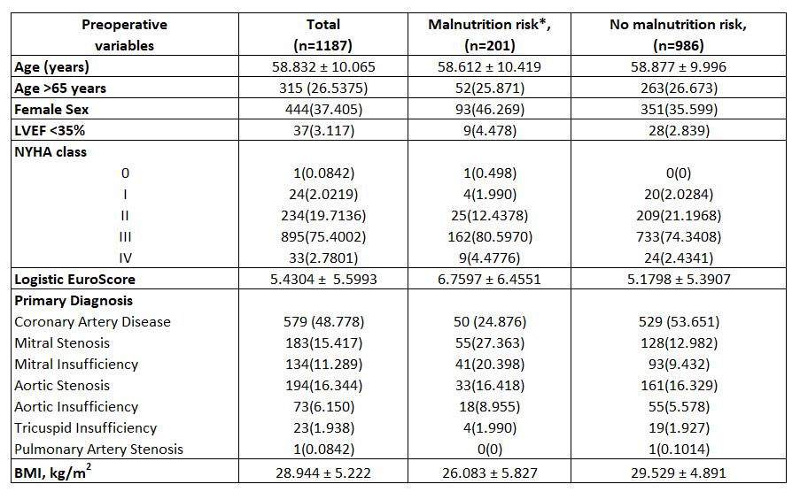
*Malnutrition risk with accordance to MUST

Slide 9
Data Discrepancies
There were several discrepancies found within the paper, and between obtained and given results:
Lost Data : The data for many patients was lost, the proportion for lost data for some of the important risk factors was as follows:
ACC time: no lost data
Age: no lost data
Albumin: 196 lost entries
CRP: 595 lost entries
CPB: no lost data
ICU: stay: no lost data
LVEF: 105 lost entries
Thrombocyte count:30 lost entries
Logistic EuroSCORE: 197 lost entries
Survival days and Death: 449 entries.
The lost data was generally dealt with by dropping them during the subsequent analysis.
In the two papers provided, the values found in Cox Models were different in each paper.
Under “8-year survival curves”, the paper has overall survival curves in most places.

Slide 10
Data
Analysis
ROC CURVES
Area under roc curves
Youden’s J statistic
Wilcoxon-Mann-Whitney U-Statistic test
Conclusion

Slide 11
Data Analysis: Introduction
The original dataset contains 1187 observations (rows) and 40 variables (columns). Part of lost-to-follow-up observations (449 rows) were dropped during data analysis.
The initial goal was determination of cut-off point for the purpose of further converting the numeric variable to factorial type.
ROC(Receiver Operating Characteristic) analysis was performed for the following 8 variables: Pre- operative albumin level (g/l), Preoperative C-reactive protein level (mg/l), Cardiopulmonary bypass time (min), Aortic cross clamp time (min), Preoperative thrombocytes level (x10⁹ /l), Left ventricle ejection fraction (%), Age (years), ICU stay (days) as predictors of death in 3 years periods, 8 years periods and Overall Survival of patients of follow-up in mixed, CAD, and HVD cohorts

Slide 12
Data Analysis: Introduction
The target value for cut-off point was determined by selecting maximal Youden’s J statistic (sensitivity + specificity –1).
The corresponding value of numeric variable was used as the threshold for converting variables into two-level factor variables (low/high, with/without risk).
For every ROC curve, AUC was determined using a statistical package function. P-value for AUC was determined using the Wilcoxon-Mann-Whitney U-Statistic test.

Slide 13
Data Analysis: ROC Curves
An ROC Curve is a technique for visualizing, organizing, and selecting classifiers based on their performance. A classification model (or classifier) is a mapping from instances to predicted classes.
Given a classifier and an instance, there are four possible outcomes. If the instance is positive and it is classified as positive, it is counted as a true positive; if it is classified as negative, it is counted as a false negative. If the instance is negative and it is classified as negative, it is counted as a true negative; if it is classified as positive, it is counted as a false positive.

Slide 14
Data Analysis: ROC Curves
Formulae:
ROC Curves are the plots of Sensitivity vs. 1-Specificity

Slide 15
Data Analysis: Area Under an ROC Curve
ROC curves are two-dimensional depictions of classifier performance. To compare classifiers, we want a single scalar value representing expected performance. Area under the ROC curve is often used as this scalar value.
Since the area is a portion of the area of the unit square, its value will always be between 0 and 1. A random classifier will give a diagonal line joining (0, 0) and (1, 1) as the ROC curve. Thus, its AUC will be 0.5.

Slide 16
Data Analysis: Area Under an ROC Curve
Statistically, the importance of the AUC is that higher the value of AUC, better are the predictions of the classifier:
1. AUC = 1. This implies that the classifier can perfectly distinguish between all the positives and negatives.
2. AUC = 0. This implies that the classifier predicts all positives as negatives and all negatives as positives.
3. AUC = 0.5 This implies that the classifier is unable to distinguish between the positives and the negatives. Thus, it is equivalent to a random classifier.
Note that when AUC is between 0.5 and 1, it implies that the classifier can detect a greater number of true positives and true negatives than false positives and false negatives. Thus, any ROC curve having an AUC less than 0.5 will not be useful to us as its predictions will be highly inaccurate.

Slide 17
Data Analysis: Youden’s J Statistic
After we plot ROC curves, we try to find the cut-off value using Youden’s J Statistic.
Let: 𝑎 = 𝑇𝑟𝑢𝑒 𝑃𝑜𝑠𝑖𝑡𝑖𝑣𝑒𝑠, 𝑏 = 𝐹𝑎𝑙𝑠𝑒 𝑁𝑒𝑔𝑎𝑡𝑖𝑣𝑒𝑠, 𝑐 = 𝑇𝑟𝑢𝑒 𝑁𝑒𝑔𝑎𝑡𝑖𝑣𝑒𝑠, 𝑑 = 𝐹𝑎𝑙𝑠𝑒 𝑃𝑜𝑠𝑖𝑡𝑖𝑣𝑒𝑠
Then, a reasonable measure of success for the positives will be:
(𝑎−𝑏)/(𝑎+𝑏)
Similarly, a reasonable measure of success for the negatives will be:
(𝑐−𝑑)/(𝑐+𝑑)
Assuming that false positives are as undesirable as false negatives, we can take an average of the two measures of success as a “rating” for the model, i.e., how accurate the predictions of the classifier are.

Slide 18
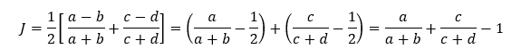
Data Analysis: Youden’s J Statistic
∴
∴ 𝐽=𝑆𝑒𝑛𝑠𝑖𝑡𝑖𝑣𝑖𝑡𝑦+𝑆𝑝𝑒𝑐𝑖𝑓𝑖𝑐𝑖𝑡𝑦−1
J is known as “Youden’s J Statistic” or “Youden’s Index”
So, the threshold value that gives the maximum value of J from the graph is our required cut-off point.
In R, coords(,"best") gives us the cut-off value and respective values of specificity and sensitivity using Youden J.

Slide 19
Data Analysis: Wilcoxon-Mann-Whitney U-Statistic test
In this study, the p-value of the Mann-Whitney-Wilcoxon (MWW) non-parametric statistical hypothesis test was used to measure the statistical significance of the dependence of death of a patient on various factors.
The test was carried out in R software through the “wilcox.test()” function, as a 2-sided test, with a confidence level of 0.95, i.e. with a significance level α of 0.05.

Slide 20
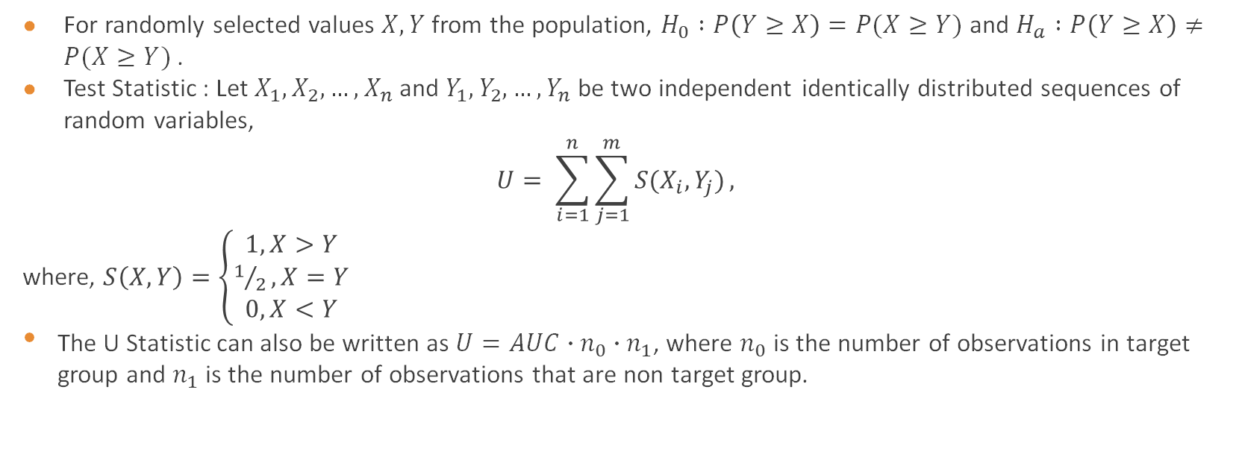
Data Analysis: Wilcoxon-Mann-Whitney U-Statistic test
For randomly selected values $X, Y$ from the population, $H_{0} :P\left(Y≥X\right)=P(X≥Y)$ and $H_{a} :P\left(Y≥X\right)≠P(X≥Y)$ .
Test Statistic : Let $X_{1}, X_{2},…, X_{n}$and $Y_{1}, Y_{2},…, Y_{n}$ be two independent identically distributed sequences of random variables,
$$U= \sum_{i=1}^{n}{\sum_{j=1}^{m}{S(X_{i}, Y_{j})}},$$
where, $S\left(X,Y\right)=\left\{\begin{aligned}1, X>Y \\ 1/2, X=Y \\ 0, X<Y\end{aligned}\right.$
The U Statistic can also be written as $U=AUC∙n_{0}∙n_{1}$, where $n_{0}$ is the number of observations in target group and $n_{1}$ is the number of observations that are non target group.

Slide 21
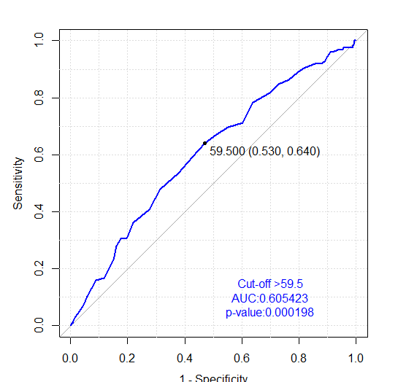
ROC plot with age as a factor against death (mixed cohort, OS)
Our data for age ranges from 19 to 83 years, so roc(data_age$Death,data_age$`Age, years`) function in R assumes threshold values from 19 to 83 and calculates the respective sensitivity and specificity value.
Then these values are plotted as Sensitivity vs 1-Specificity.
We check the AUC which is 0.605 here >0.5, with a p-value < 0.05. So, we observe significant dependence.

Slide 22
 | Threshold | Specificity | Sensitivity |  | Threshold | Specificity | Sensitivity |  | Threshold | Specificity | Sensitivity
1. | -inf | 0.00000 | 1.000 | 20. | 44.5 | 0.08156 | 0.960 | 39. | 63.5 | 0.72430 | 0.408
2. | 19.5 | 0.00163 | 1.000 | 21. | 45.5 | 0.08972 | 0.960 | 40. | 64.5 | 0.77977 | 0.360
3. | 21.5 | 0.00326 | 1.000 | 22. | 46.5 | 0.09951 | 0.944 | 41. | 65.5 | 0.80424 | 0.304
4. | 23.5 | 0.00489 | 1.000 | 23. | 47.5 | 0.10929 | 0.928 | 42. | 66.5 | 0.82544 | 0.304
5. | 25.5 | 0.00652 | 0.992 | 24. | 48.5 | 0.12398 | 0.920 | 43. | 67.5 | 0.83849 | 0.280
6. | 28.5 | 0.00978 | 0.984 | 25. | 49.5 | 0.14355 | 0.920 | 44. | 68.5 | 0.84991 | 0.232
7. | 30.5 | 0.01141 | 0.976 | 26. | 50.5 | 0.18270 | 0.904 | 45. | 69.5 | 0.86460 | 0.200
8. | 31.5 | 0.01794 | 0.976 | 27. | 51.5 | 0.20554 | 0.888 | 46. | 70.5 | 0.88417 | 0.168
9. | 32.5 | 0.02447 | 0.976 | 28. | 52.5 | 0.23654 | 0.864 | 47. | 71.5 | 0.91190 | 0.160
10. | 33.5 | 0.02773 | 0.976 | 29. | 53.5 | 0.27243 | 0.848 | 48. | 72.5 | 0.94290 | 0.104
11. | 35.0 | 0.03099 | 0.976 | 30. | 54.5 | 0.30342 | 0.816 | 49. | 73.5 | 0.95595 | 0.072
12. | 36.5 | 0.03262 | 0.976 | 31. | 55.5 | 0.36052 | 0.784 | 50. | 74.5 | 0.96900 | 0.048
13. | 37.5 | 0.03752 | 0.976 | 32. | 56.5 | 0.39641 | 0.712 | 51. | 75.5 | 0.98368 | 0.032
14. | 38.5 | 0.04078 | 0.976 | 33. | 57.5 | 0.44861 | 0.696 | 52. | 76.5 | 0.99021 | 0.016
15. | 39.5 | 0.04241 | 0.976 | 34. | 58.5 | 0.48776 | 0.672 | 53. | 77.5 | 0.99184 | 0.008
16. | 40.5 | 0.04730 | 0.968 | 35. | 59.5 | 0.53017 | 0.640 | 54. | 78.5 | 0.99347 | 0.008
17. | 41.5 | 0.05383 | 0.968 | 36. | 60.5 | 0.57259 | 0.592 | 55. | 80.0 | 0.99673 | 0.008
18. | 42.5 | 0.06199 | 0.968 | 37. | 61.5 | 0.62316 | 0.536 | 56. | 82.0 | 0.99836 | 0.000
19. | 43.5 | 0.06525 | 0.968 | 38. | 62.5 | 0.68678 | 0.480 | 57. | inf | 1.00000 | 0.000

Slide 23
ROC plot with age as a factor against death
coords(roc_age,"best") gives the cut-off value using Youden’s J statistic, here it is 59.5 years.
And, wilcox.test(data_age$`Age, years`~data_age$Death, data=data_age) gives the p-value.

Slide 24
Data Analysis: Conclusion
We perform the same procedure for all the required 8 variables on overall survival, 8-year survival and 3-year survival to calculate the AUC, cut-off points and p-values for Mixed, HVD and CAD cohorts.
We then use these cut-off values to convert the numerical data into factorial type for further Survival analysis.
We discard those variables with high p-values for our further analysis i.e. thrombocytes and LVEF.

Slide 25
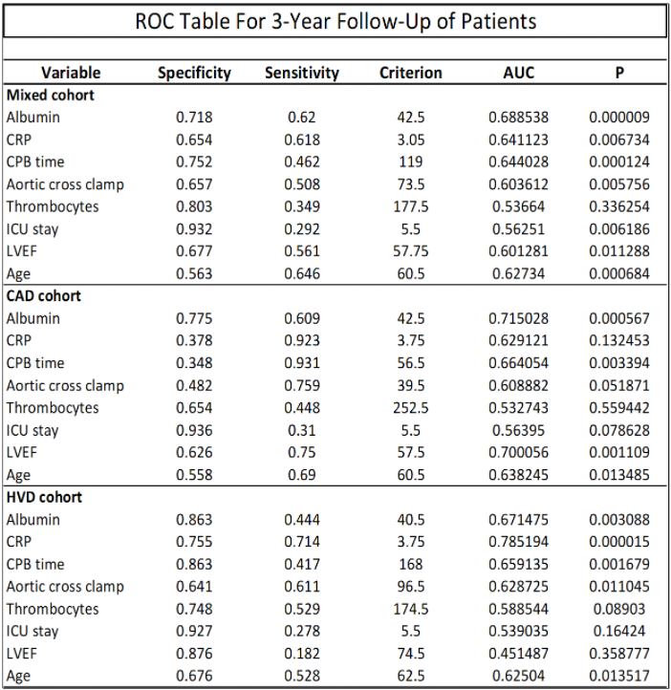
ROC table for 3 year follow up of patients

Slide 26
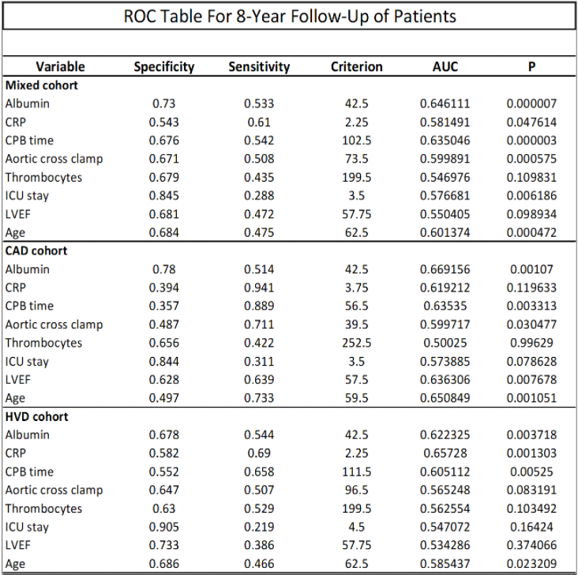
ROC table for 8 year follow up of patients

Slide 27
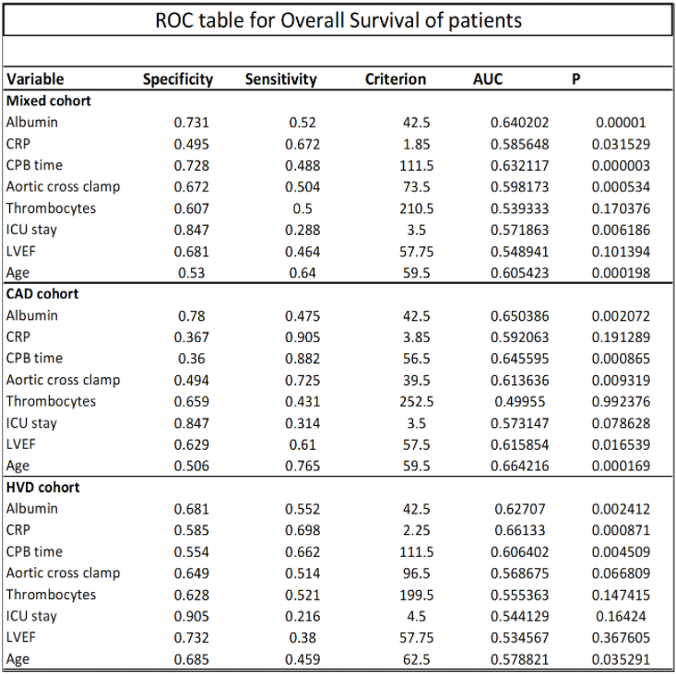
ROC table for OS follow up of patients

Slide 28
Survival Analysis
Kaplan-meier Curves
Log rank test
Cox proportional hazard models
Schoenfeld Residual test

Slide 29

Survival Analysis: Introduction
Survival Analysis: It is a modelling technique used to model time to an event i.e., it is used to determine how long it will take for an event to occur.
Survival analysis can be used to model events which will result in exclusion of the subject from consideration, events like death, end of employment with respect to an organization or first breakdown of a machine.
Here we perform survival analysis using various tools like log-rank test, Kaplan Meier curves, Cox proportional hazard model and Schoenfeld Residual test.

Slide 30
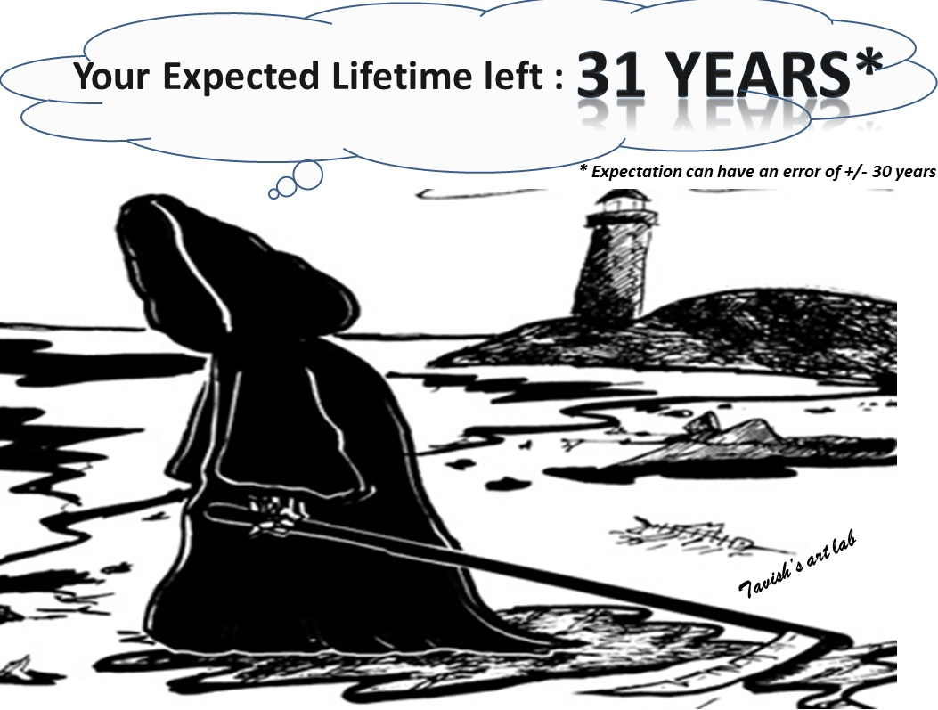
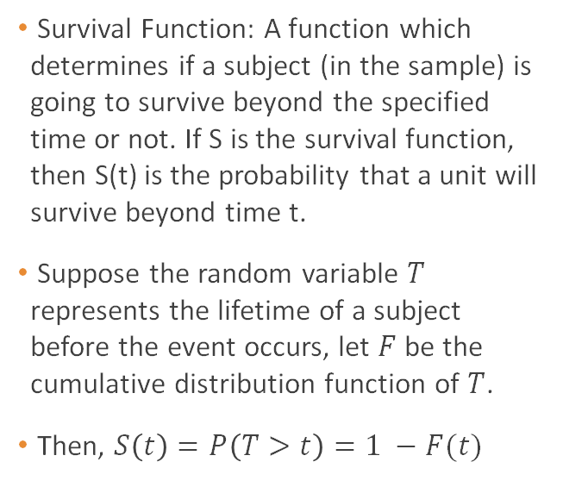
Survival Analysis: Introduction
Survival Function: A function which determines if a subject (in the sample) is going to survive beyond the specified time or not. If S is the survival function, then S(t) is the probability that a unit will survive beyond time t.
Suppose the random variable $T$ represents the lifetime of a subject before the event occurs, let $F$ be the cumulative distribution function of $T$.
Then, $S\left(t\right)=P\left(T>t\right)=1 −F(t)$

Slide 31
Survival Analysis: Kaplan Meier Curves
In survival analysis there are several possibilities regarding the follow up of the subject: the subject might drop out of study before the event has occurred, the subject has gone through the event and hence dropped out from the study, or else the subject might have not been available for the study since day one.
To draw out inference from such chaos, we use Kaplan Meier survival curves and the survival probability for the subjects in a short time interval.
The subjects for whom we have partial data due to the subject dropping out of the study or unavailability of certain parameters, we label such observations as ‘censored’

Slide 32
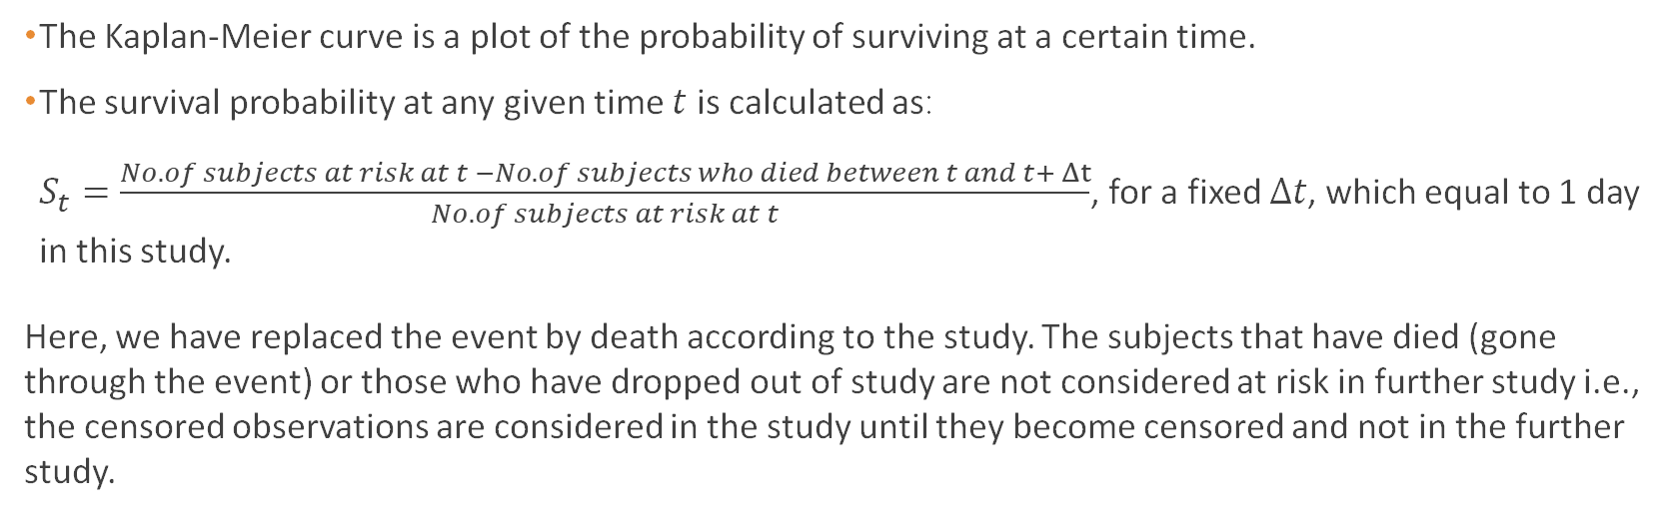
Survival Analysis: Kaplan Meier Curves
The Kaplan-Meier curve is a plot of the probability of surviving at a certain time.
The survival probability at any given time $t$ is calculated as:
$S_{t}=\frac{No. of subjects at risk at t −No. of subjects who died between t and t+ Δt}{No. of subjects at risk at t}$, for a fixed $∆t$, which equal to 1 day in this study.
Here, we have replaced the event by death according to the study. The subjects that have died (gone through the event) or those who have dropped out of study are not considered at risk in further study i.e., the censored observations are considered in the study until they become censored and not in the further study.

Slide 33
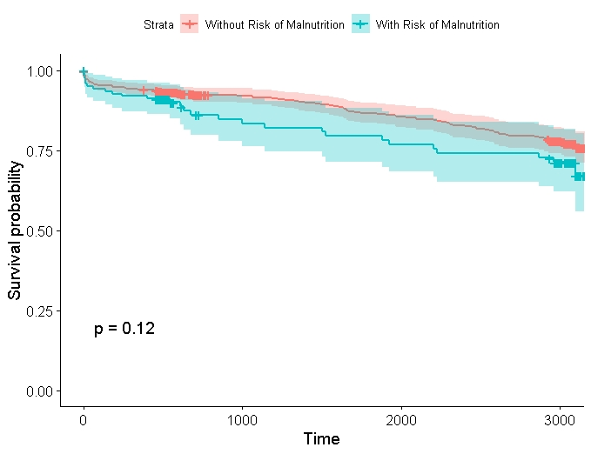
Kaplan Meier Curves of OS with respect to Malnutrition
The plot to the right shows two different curves which correspond to separate subsets of the sample data. The ‘blue’ curve corresponds to subjects with risk of malnutrition and the ‘red’ corresponding to subjects with no risk.
Generally, the Kaplan Meier curves are used to compare survival probabilities for different groups of subjects based on some characteristics related to the study.
The p-value is calculated using log rank test, which will be discussed next.

Slide 34
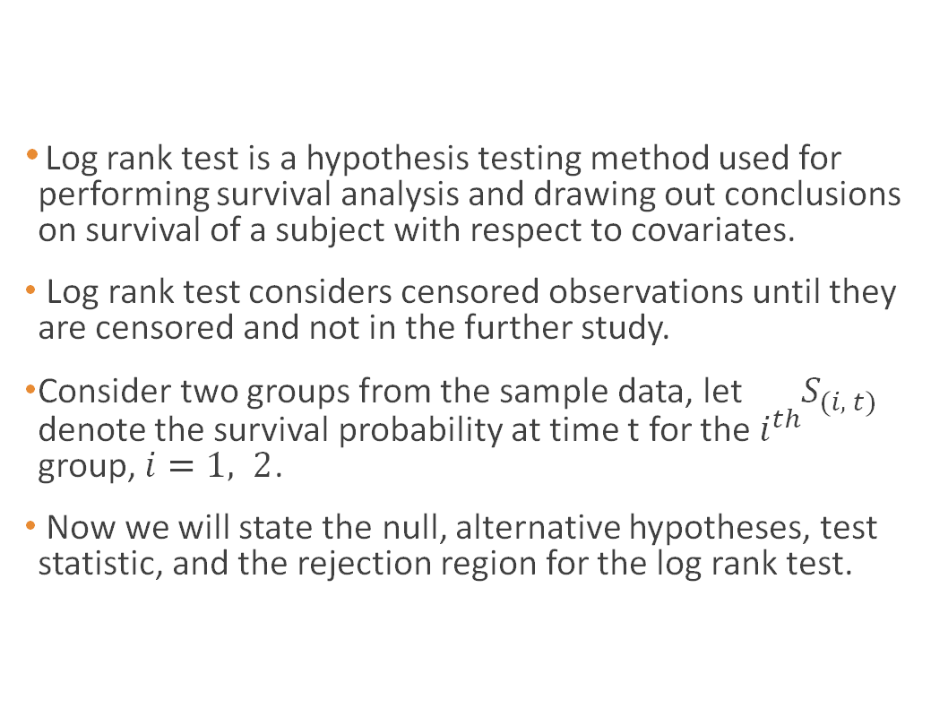
Survival Analysis: Log rank test
Log rank test is a hypothesis testing method used for performing survival analysis and drawing out conclusions on survival of a subject with respect to covariates.
Log rank test considers censored observations until they are censored and not in the further study.
Consider two groups from the sample data, let $S_{(i, t)}$ denote the survival probability at time t for the $i^{th}$ group, $i=1, 2$.
Now we will state the null, alternative hypotheses, test statistic, and the rejection region for the log rank test.

Slide 35
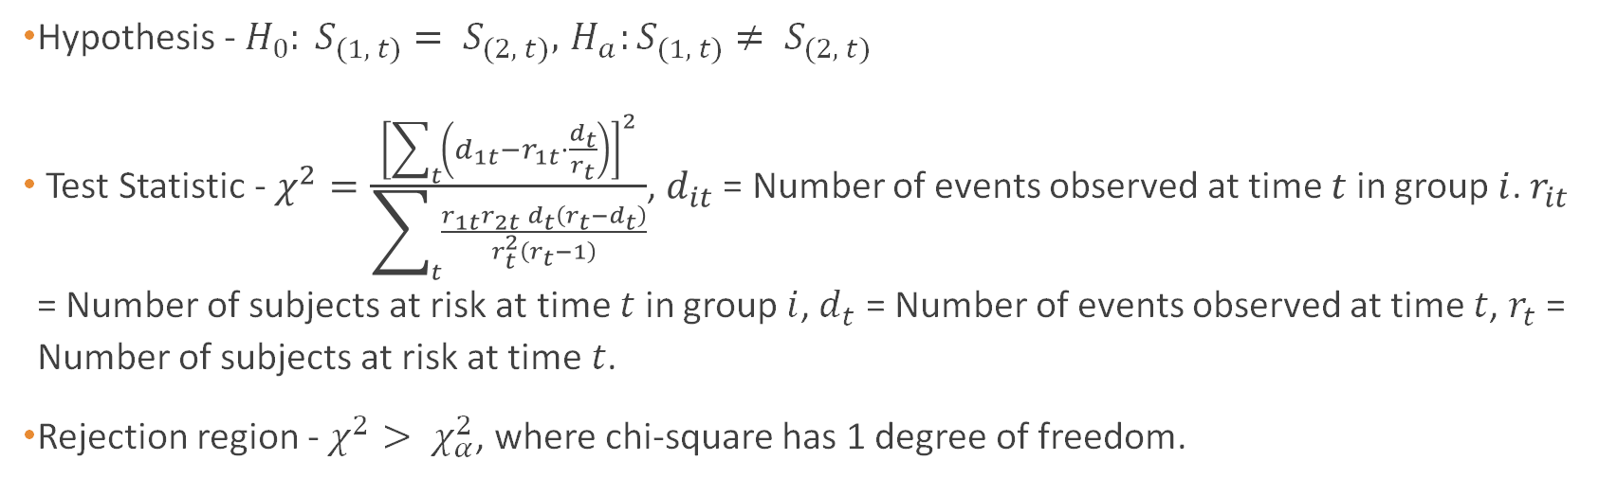
Survival Analysis: Log rank test
Hypothesis - $H_{0}: S_{(1, t)}= S_{(2, t)}, { H}_{a}:S_{(1, t)}≠ S_{(2, t)}$
Test Statistic - $χ^{2}=\frac{{\left[\sum_{t}{\left(d_{1t}−r_{1t}⋅\frac{ⅆ_{t}}{r_{t}}\right)}\right]}^{2}}{\sum_{t}{\frac{r_{1t}r_{2t}ⅆ_{t}\left(r_{t}−ⅆ_{t}\right)}{r_{t}^{2}\left(r_{t}−1\right)}}}$, $d_{it}$ = Number of events observed at time $t$ in group $i$. $r_{it}$ = Number of subjects at risk at time $t$ in group $i$, $d_{t}$ = Number of events observed at time $t$, $r_{t}$ = Number of subjects at risk at time $t$.
Rejection region - $χ^{2}> χ_{α}^{2}$, where chi-square has 1 degree of freedom.

Slide 36
Survival Analysis: Cox Proportional Hazard Model
Before defining Cox proportional hazard model, we need to define hazard, hazard rate, and hazard ratio.
Hazard: It is the probability of occurrence of the event in the next time interval, given that it has not occurred yet.
Hazard Rate: It is the hazard divided by the length of the time interval. Hazard rate represents an instantaneous rate when we consider the length of the time interval to be very small compared to overall duration of the study.
Hazard Ratio: It is an estimate of the ratio of the hazard rate of one group to the hazard rate of the other.

Slide 37

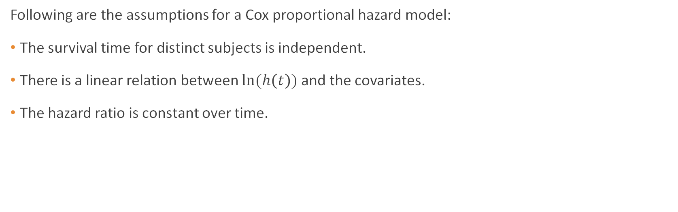
Survival Analysis: Cox Proportional Hazard Models
Following are the assumptions for a Cox proportional hazard model:
The survival time for distinct subjects is independent.
There is a linear relation between $ln⁡(h\left(t\right))$ and the covariates.
The hazard ratio is constant over time.

Slide 38
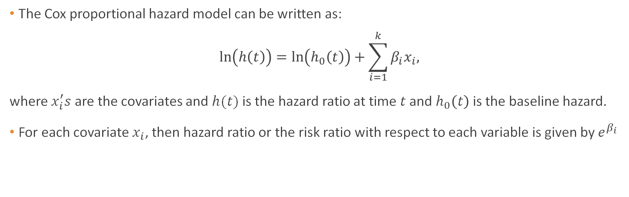
Survival Analysis: Cox Proportional Hazard Models
The Cox proportional hazard model can be written as:
$$\ln\left(h\left(t\right)\right)=\ln\left(h_{0}\left(t\right)\right)+\sum_{i=1}^{k}{β_{i}x_{i},}$$
where $x_{i}^{′}s$ are the covariates and $h(t)$ is the hazard ratio at time $t$ and $h_{0}\left(t\right)$ is the baseline hazard.
For each covariate $x_{i}$, then hazard ratio or the risk ratio with respect to each variable is given by $e^{β_{i}}$

Slide 39
Survival Analysis: Cox Proportional Hazard Model
Cox Proportional Hazard Model is used to perform univariate and multivariate analysis in this study using ‘coxph’ function from ‘survival’ R packages.
Univariate and multivariate Cox PH model are built for the following covariates: Logistic Euroscore, MUST, albumin levels, C-reactive protein, cardiopulmonary bypass time, ICU stay, aortic cross clamp time and age for each of 3-year, 8-year, overall survivals.
The Cox proportional hazard model outputs the hazard ratio, it’s 95% confidence intervals and the p-value for the null hypothesis that the coefficient $β_{i}=0$. The p-values decide whether a covariate affects the survival or not.
The Cox proportional hazard model outputs the hazard ratio, it’s 95% confidence intervals and the p-value for the null hypothesis that the coefficient 𝛽_𝑖=0. The p-values decide whether a covariate affects the survival or not.
The hazard ratio indicates how the covariate affects the survival. If the hazard ratio is greater than 1, increase in the covariate decreases the survival, if the hazard ratio is equal to 1, the covariate doesn’t affect the survival, if the hazard ratio is less than 1, increase in the covariate increases the survival.

Slide 40
Survival Analysis: Cox Proportional Hazard Model
A full Mixed Multivariate Cox proportional hazard model and two Optimal Multivariate Cox proportional hazard models are built, based on the previous analysis.
First Optimal multivariate model is the Optimal Multivariate Cox PH model in the provided data paper.
Second Optimal multivariate model is build using the backward selection process. In backward selection process, we build a full mixed model and in each step we remove the covariate with highest p-value.

Slide 41
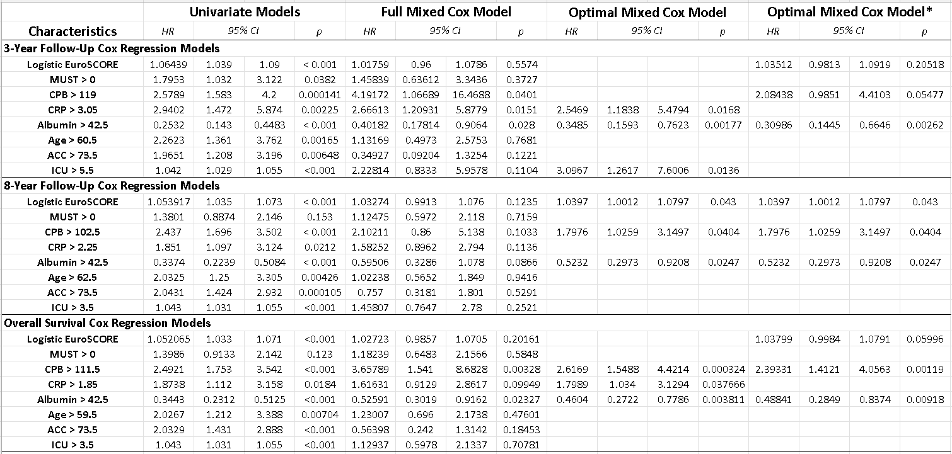
Following are the results from all the Cox Proportional Hazard Models:

Slide 42
Survival Analysis: Cox Proportional Hazard Model
Conclusions:
Pre-operative malnutrition affects 3-year survival in the subjects as the p-value corresponding to univariate model of MUST is 0.038.
The first model implies that Logistic EuroSCORE, CPB time and Albumin levels significantly affect 3-year, 8-year, overall survival.
The second model concludes that ICU Stay, CRP and Albumin levels significantly affect 3-year survival.
The second model concludes that Logistic EuroSCORE, CPB time and Albumin levels significantly affect 8-year survival.
The second model concludes that CPB time, CRP and Albumin levels significantly affect overall survival.

Slide 43
However, are we sure our models are valid?
We now verify one of our major assumptions in the Cox PH Models
The assumption of proportional hazards.

Slide 44
Survival Analysis: Schoenfeld Residual Test
The Schoenfeld Residual Test is used to test the 3rd assumption made for Cox proportional hazard models - "The hazard ratio is constant over time."
In the Schoenfeld residual test, our null hypothesis is that the hazard ratio is constant throughout.
The Schoenfeld residuals are not defined for censored observations. Hence, we only consider those observations for which data till the end of the study is available.
To obtain the results of this test, we do not go into the Mathematics behind it, but use the plot for the same, which can be generated using R (packages "survival" and "survminer"; functions "cox.zph" and "ggcoxzph").
The plot is of the log of the hazard ratio vs time. As the hazard ratio is constant, its log should also be constant. We get a curve (solid black line), which should have slope nearly 0, for the proportional hazards assumption to hold.
The plot also gives a p-value and 95% confidence intervals (represented by dashed lines).
We do not want our null hypothesis to be rejected. Thus, a high p-value is favourable.

Slide 45
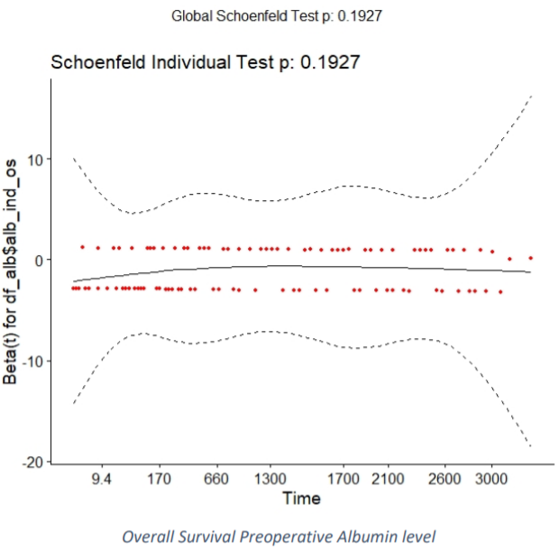
Survival Analysis: Schoenfeld Residual Test
Here we have a plot of log of hazard ratio versus time for Cox PH model of OS with respect to Albumin levels.
The ‘red’ points represent the scaled Schoenfeld Residuals.
The solid black curve is the best fit curve for the natural log of hazard ratio. The dashed lines represents the 95% CI for the same.

Slide 46
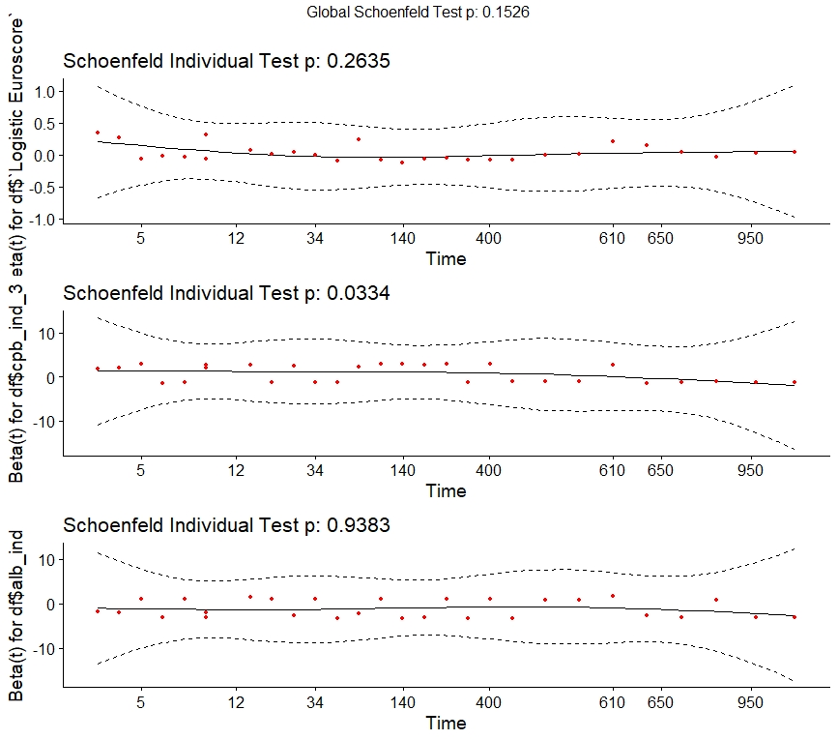
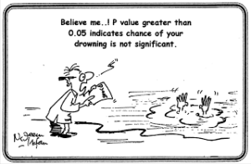
Here we look at the Schoenfeld Test for an optimal model.
The test now will be carried out for each variable in the optimal model.
Finally, it will give a global p-value which will be with respect to the entire optimal Cox Model.
This shows that a significant non-proportionality may make no difference to the interpretation of a data set, particularly if the sample size is large.
Hence, we do not just depend on p-values, but also try to get conclusions from the graph.

Slide 47
Survival Analysis: Schoenfeld Residual Test
Following are the results obtained in Schoenfeld Residual Test:
In 3 year survival models, for the univariate Cox PH models of the following covariates, the Schoenfeld test doesn’t reject the null hypothesis: MUST, CRP, Age, Albumin, ICU Stay. The optimal multivariate models have a sufficiently high p-value, which supports the null hypothesis.
In 8 year and overall survival, all the univariate and optimal multivariate models have a sufficiently large p-value except in the univariate Cox PH model for ICU stay.
Therefore, most of the Cox proportional hazard models that were used to draw conclusions can be considered valid due to the Schoenfeld Residual test.

Slide 48
Linear Regression

Slide 49
Linear Regression
Finally, we take into account that serum albumin level can be affected by C-Reactive Protein level, MUST, and the New York Heart Association (NYHA) class. Hence, we investigate their relation using regression analysis.
We used two methods:
Remove NULL observations: Replace NULL observations by mean:
CRP and Albumin: r² = 0.0486, r = -0.22, p < 0.0001 CRP and Albumin: r² = 0.0219, r = -0.148, p < 0.0001
MUST and Albumin: r² = 0.0245, r = -0.156, p < 0.0001 MUST and Albumin: r² = 0.0201, r = -0.142, p < 0.0001
NYHA and Albumin: r² = 0.0134, r = -0.116, p = 0.0003 NYHA and Albumin: r² = 0.0105, r = -0.102, p = 0.0004
Hence, as r is close to 0 in most cases, we can consider these variables to have almost no linear relationship.

Slide 50
Conclusion

Slide 51

Conclusion
Following conclusions are obtained from Kaplan Meier Curves:
Malnutrition is associated with worse 3-year survival outcome after cardiac surgery.
Significant differences in survival disappear over time.
Preoperative Albumin level positively affect each of the 3-year, 8-year and overall survival after cardiac surgery.

Slide 52
Limitations

Slide 53
Limitations
Out of 1187 patients, 449 were lost to follow up. This can cause a problem if more people from one group are lost to follow-up compared to the other. However, as the number of subjects who dropped out of study is nearly same in the two groups divided with respect to malnutrition, it is reasonable to assume that these patients will not affect the results of this study.
Surgical risk was evaluated using Logistic EuroSCORE, which has now been replaced with a more sensitive EuroSCORE.
Survival is the only outcome parameter of this study. Measure of quality of life, hospitalization, and measure of cerebrovascular complications should also be considered.

Slide 54
Acknowledgement
We would like to express our gratitude to Professor Rituparna Sen for providing us with this wonderful opportunity to work on this project and for her immense support and guidance throughout. We also thank the authors of the original paper and the articles that we referred during the project.

Slide 55


